Slide 1
Open Science
Regime Shifts
Invasion Ecology
Avian Ecology

Slide 2
Avian Ecology

Slide 3
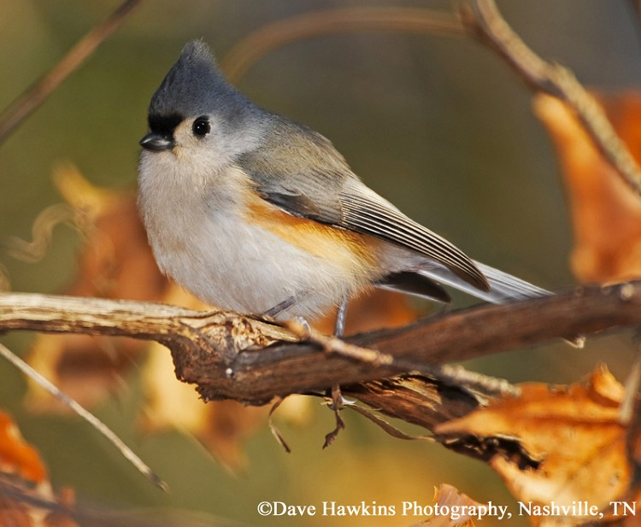
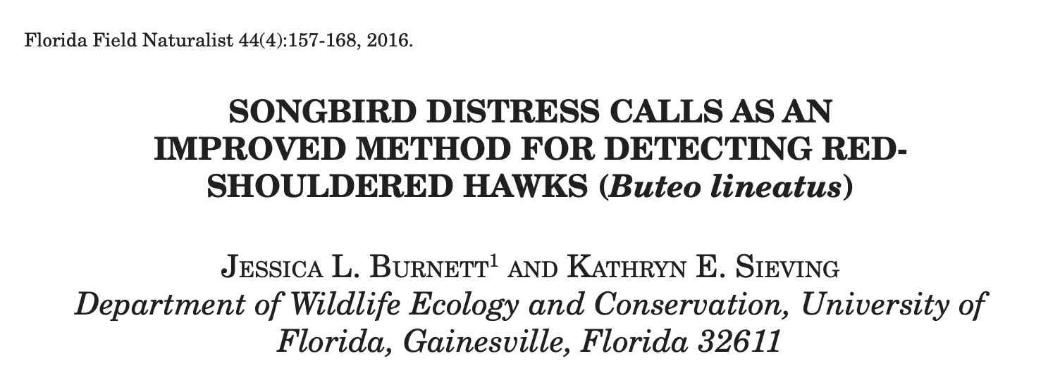
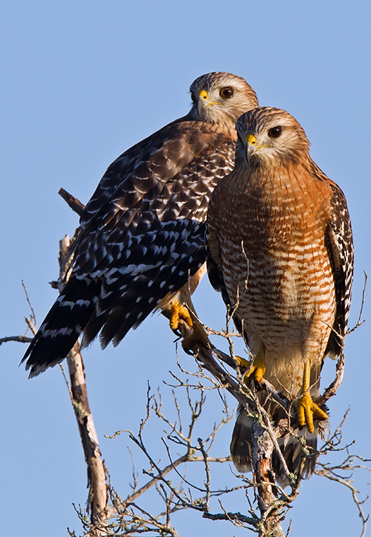
Avian Ecology

Slide 4
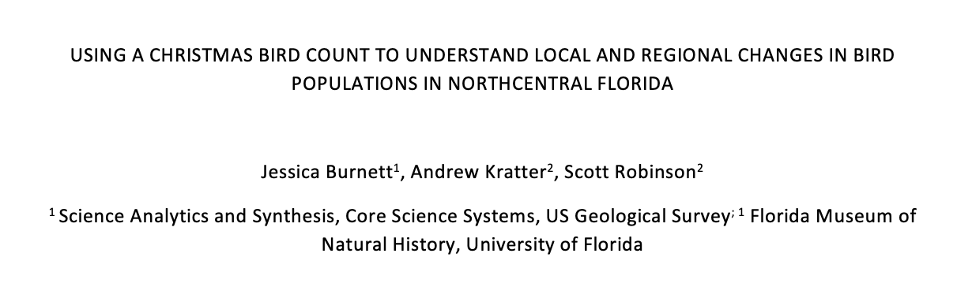
Avian Ecology

Slide 5
Invasion Ecology
Avian Ecology

Slide 6
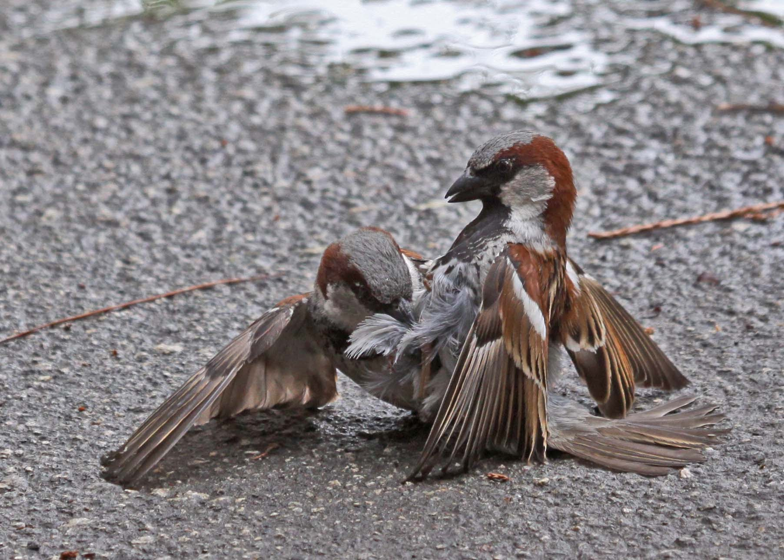
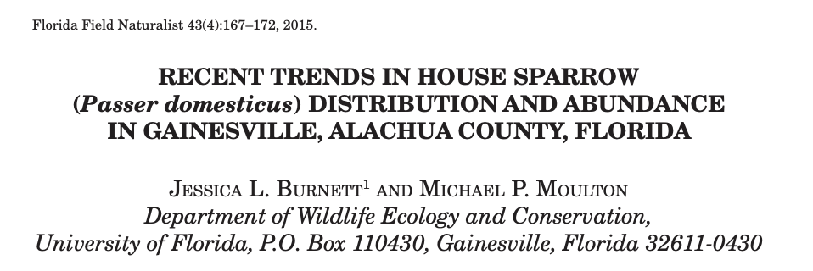
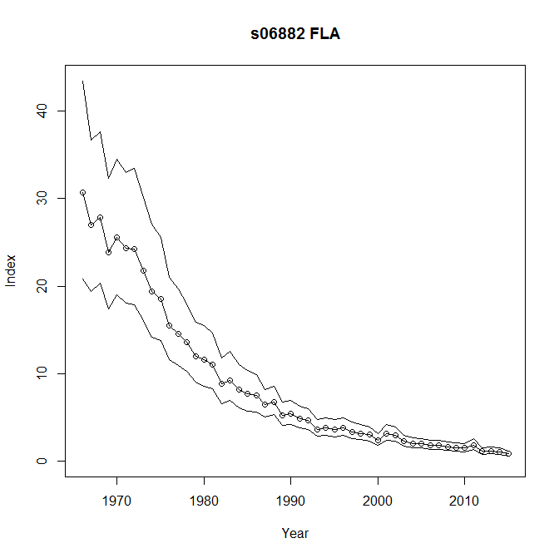
Invasion Ecology
Avian Ecology

Slide 7
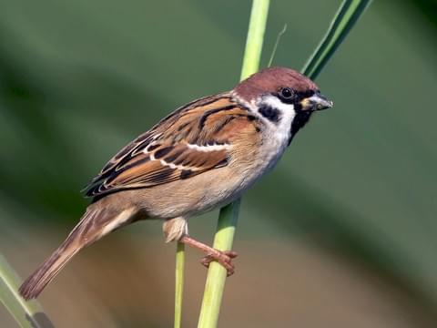
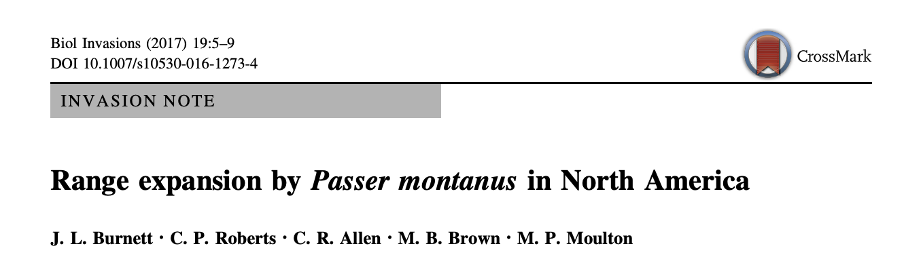
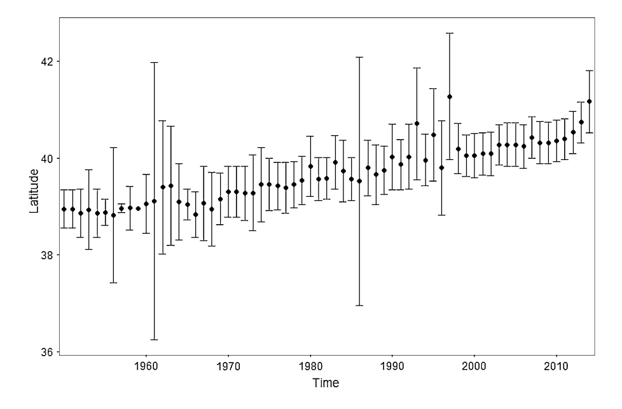
Invasion Ecology
Avian Ecology

Slide 8
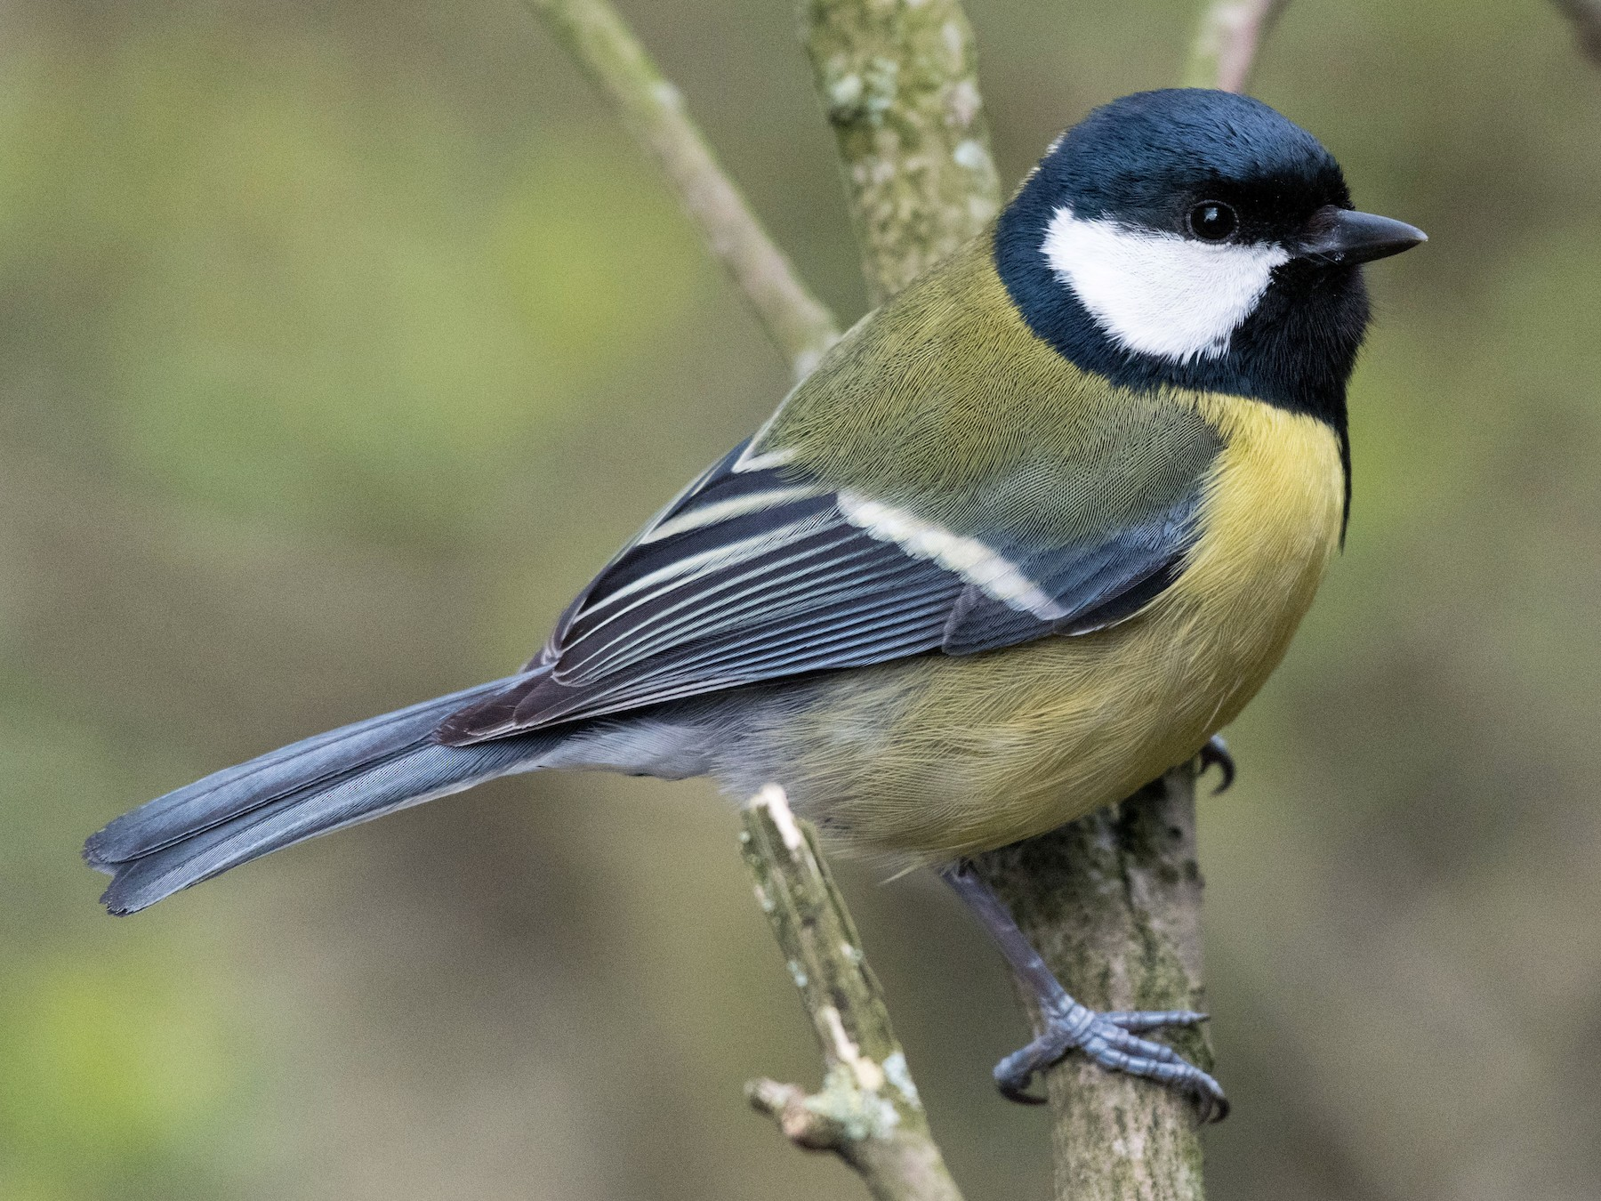
Invasion Ecology
Avian Ecology

Slide 9
Invasion Ecology
Avian Ecology

Slide 10
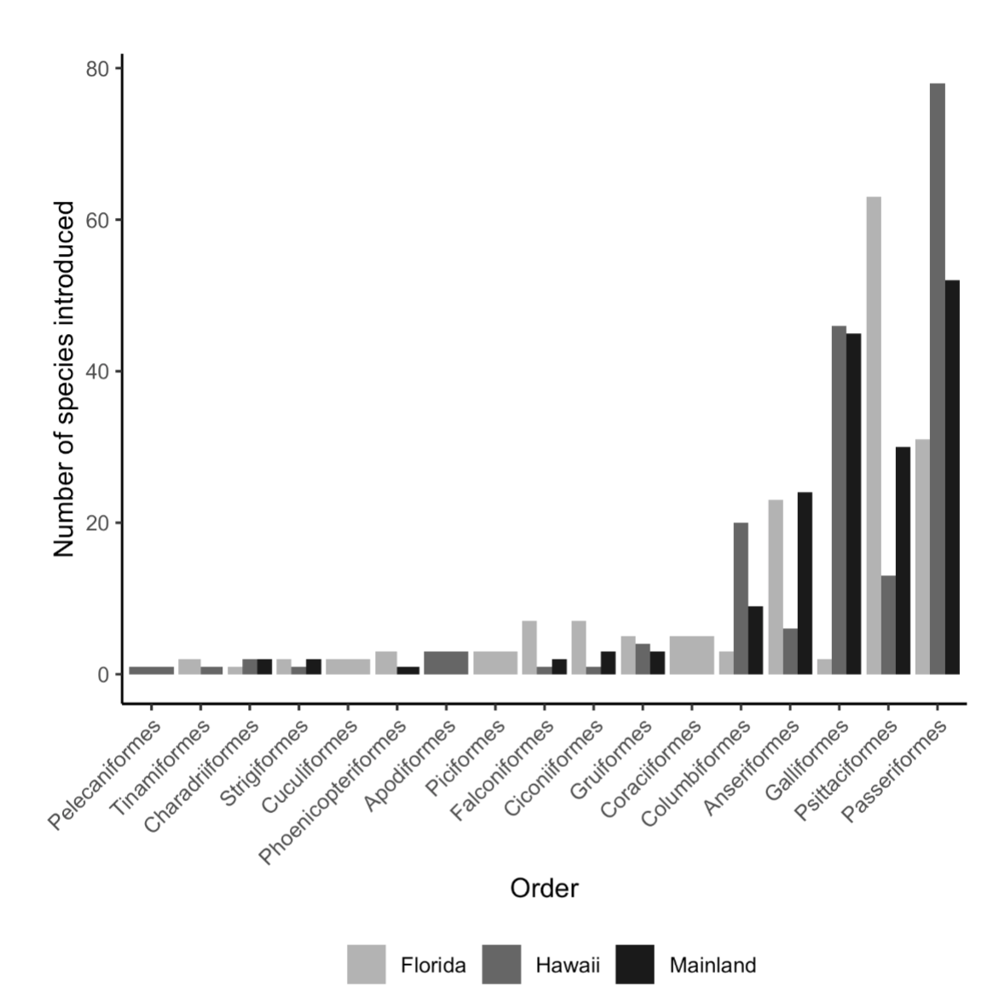
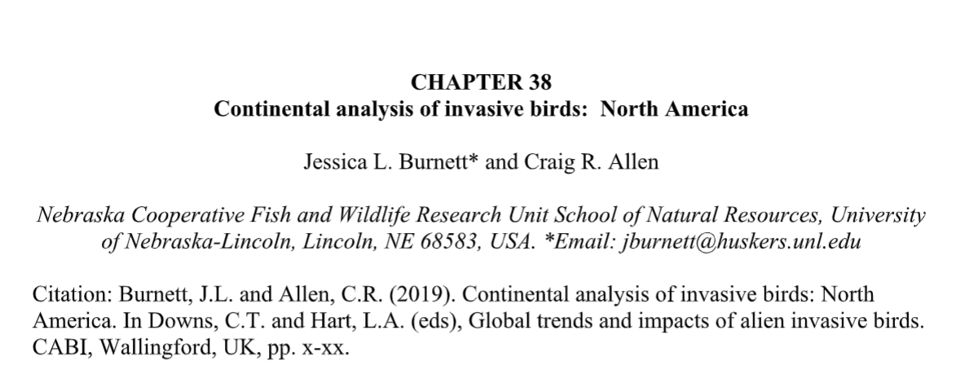
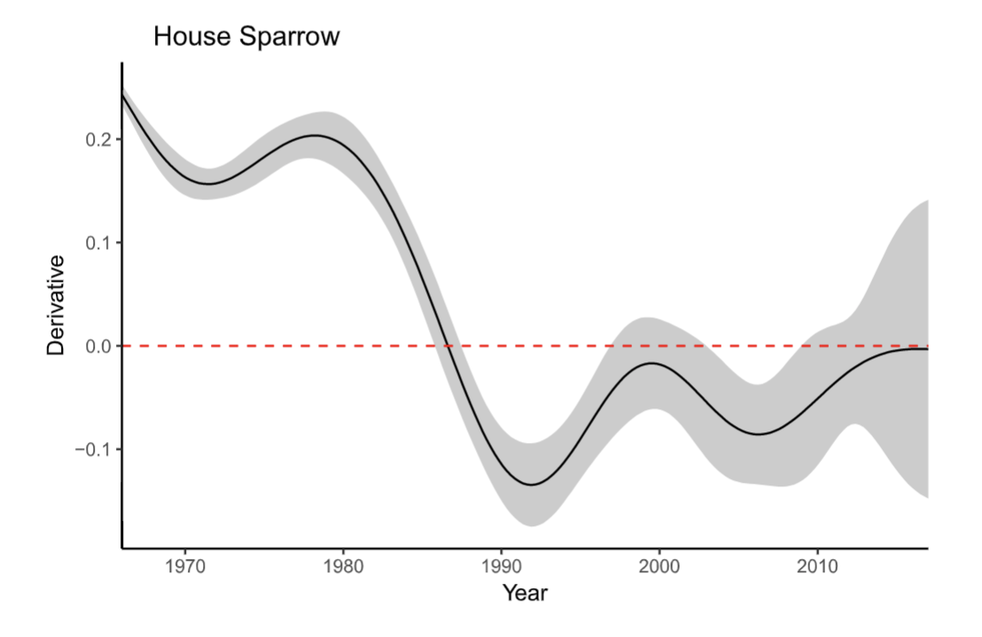
Invasion Ecology
Avian Ecology

Slide 11
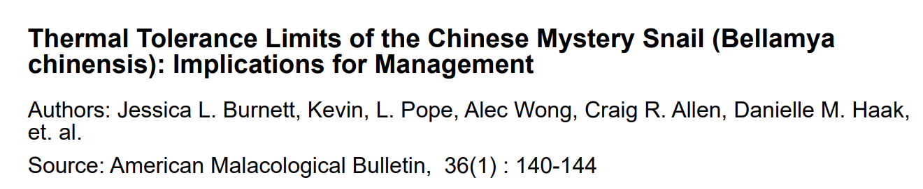
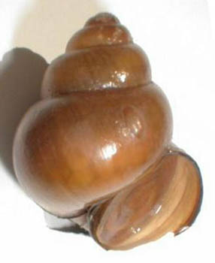
Upper limit: ~ 45℃
Lower limit: < 0 ℃
Invasion Ecology
Avian Ecology

Slide 12
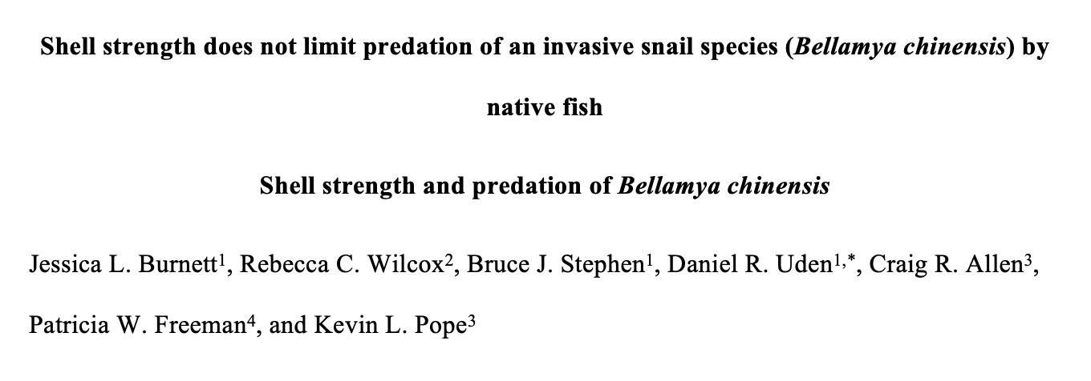
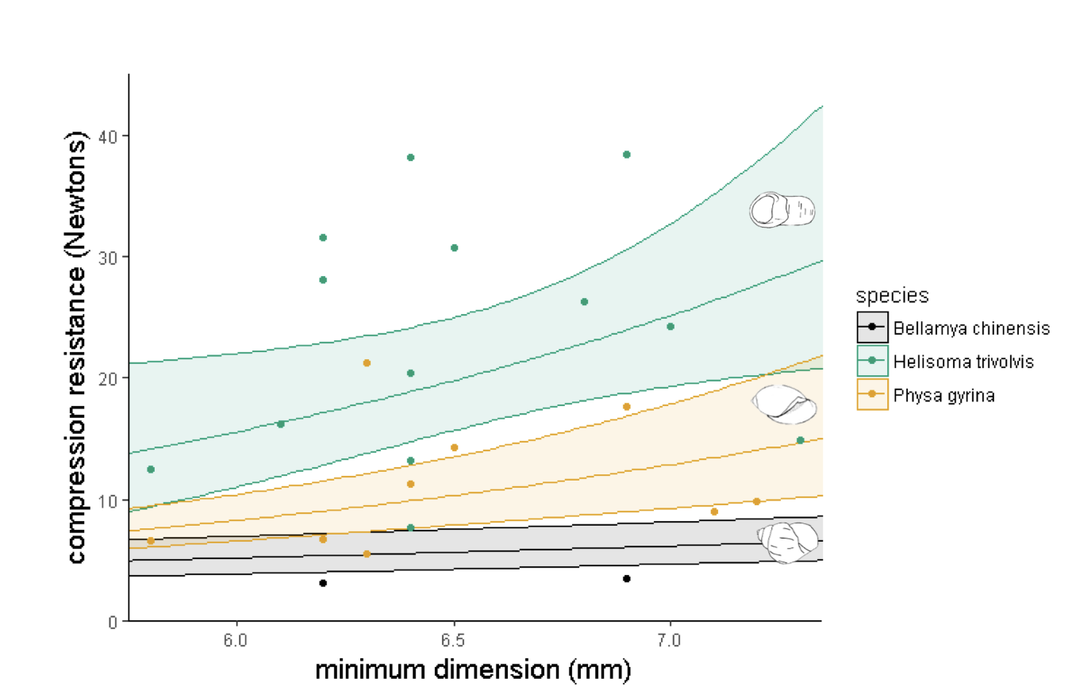
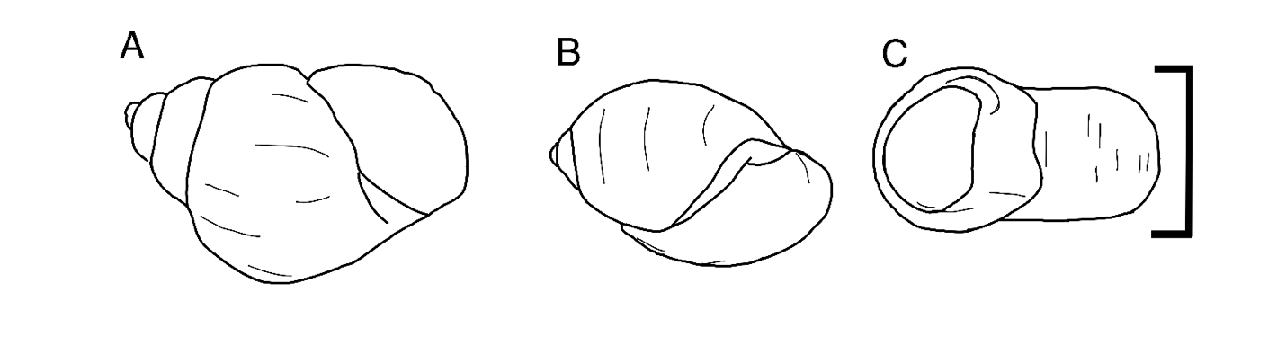
Invasion Ecology
Avian Ecology

Slide 13
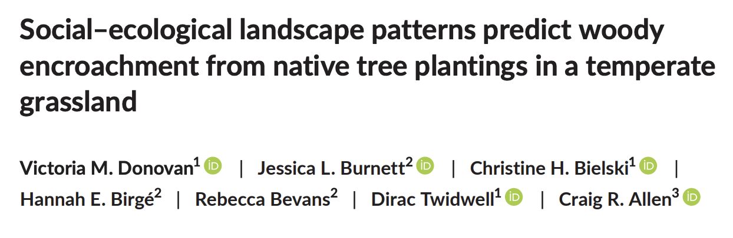
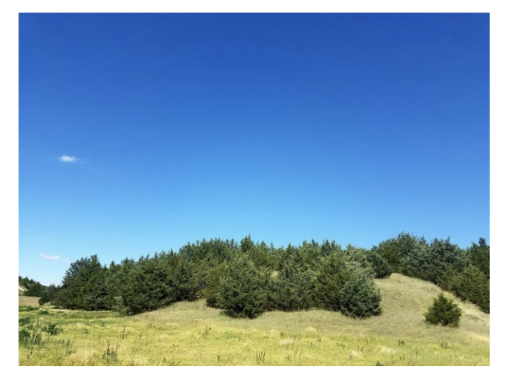
Invasion Ecology
Avian Ecology

Slide 14
Regime Shifts
Invasion Ecology
Avian Ecology

Slide 15
Regime Shifts
Invasion Ecology
Avian Ecology

Slide 16
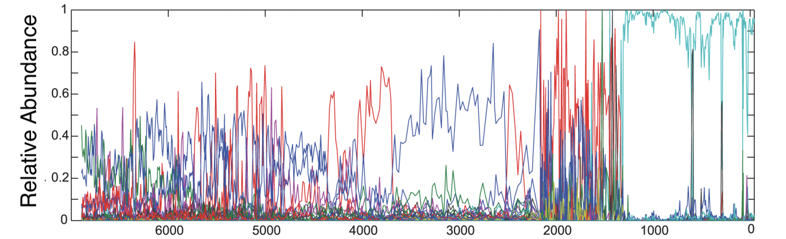
Regime Shifts
Invasion Ecology
Avian Ecology

Slide 17
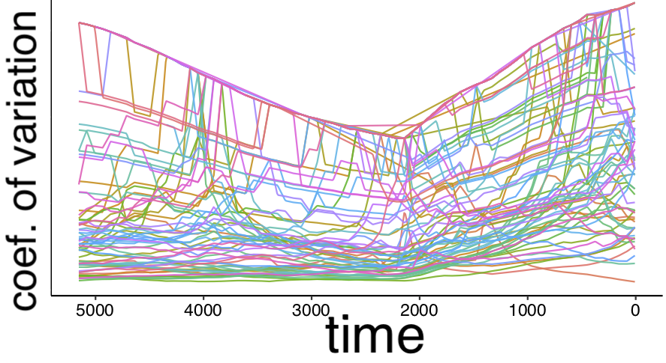
Regime Shifts
Invasion Ecology
Avian Ecology

Slide 18
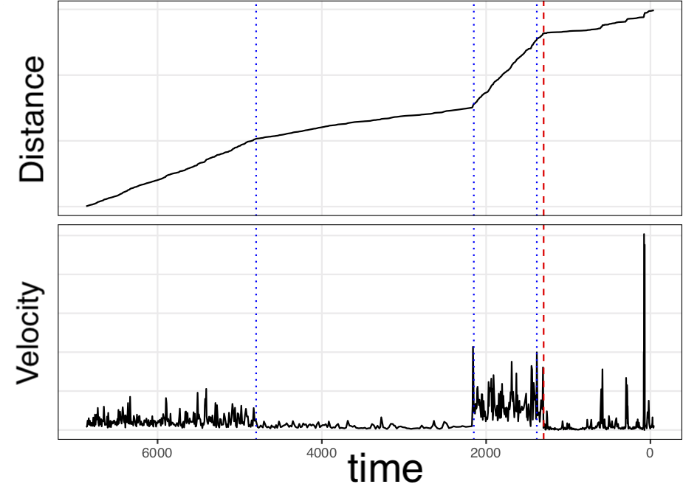
Regime Shifts
Invasion Ecology
Avian Ecology

Slide 19
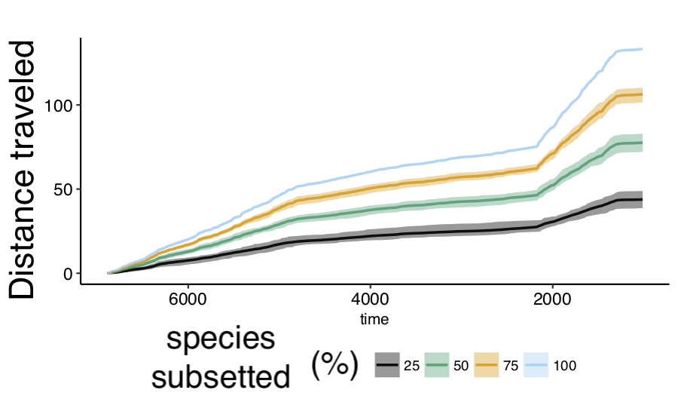
Regime Shifts
Invasion Ecology
Avian Ecology

Slide 20
Open Science
Regime Shifts
Invasion Ecology
Avian Ecology

Slide 21
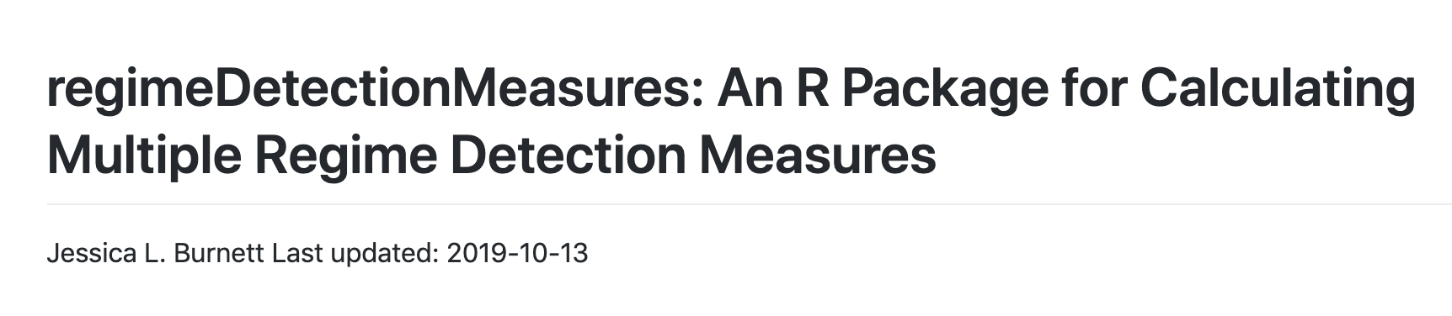

Open Science
Regime Shifts
Invasion Ecology
Avian Ecology

Slide 22
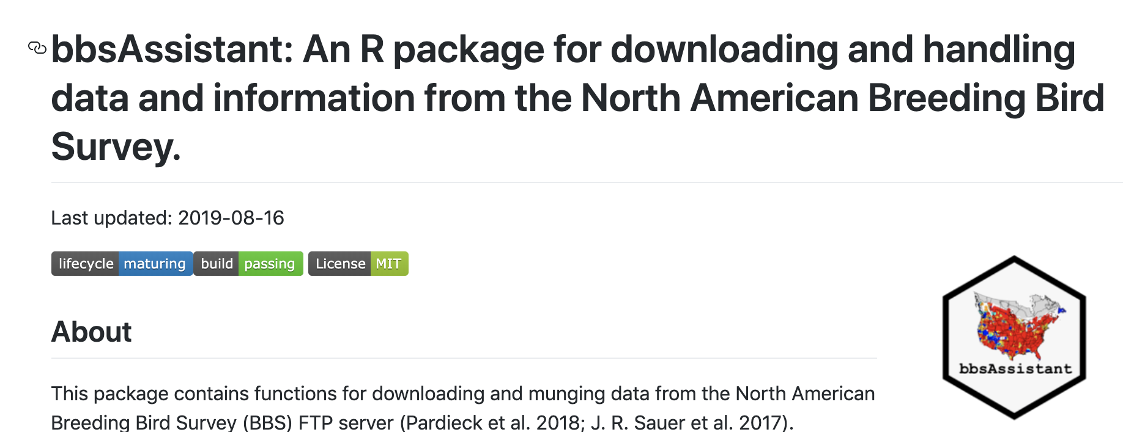
Open Science
Regime Shifts
Invasion Ecology
Avian Ecology

Slide 23
INFORMATION SCIENCE
Open Science
Regime Shifts
Invasion Ecology
Avian Ecology

Slide 24

INFORMATION SCIENCE
Open Science
Regime Shifts
Invasion Ecology
Avian Ecology

Slide 25
INFORMATION SCIENCE
Information Science
Regime Shifts
Invasion Ecology
Avian Ecology

Slide 26
INFORMATION SCIENCE
End-users
Practitioners
Decision Makers
Open Science
Regime Shifts
Invasion Ecology
Avian Ecology

